Slide 1
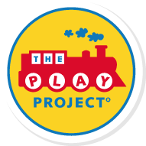
Autism & Anxiety: Part 2 When Anxiety Becomes a Disorder
Richard Solomon, MD
Medical Director and Founder
The PLAY Project
March 23, 2022
Notes:
Can we get the PLAY logo on here somewhere?

Slide 2
Part 2: Overview
Anxiety Disorder
OCD
Depression
Anxiety
(To Choke)
Fear
(Calamity, danger, revere)
Part 2
Today
Part 1
The Case of Billy

Slide 3
In Autism & Anxiety: Part 1
I presented the case for using anxiety and upset to promote coping, resilience, and improved development. In short to help improve emotional intelligence
Two-edged sword: The higher development, the more fears and anxieties
If not recognized and handled well it can not only impair developmental progress but lead to chronic anxiety
Fear, Panic, and Rage are ‘built in’ to our brains (Panksepp)
He comes by it honestly: The Genetics of Anxiety
Socially – there are so many fears and worries that the child cannot cope and all efforts to self regulate don’t work
How do we help our poor kids with autism with all the demands and stresses of life?
Notes:
But you can’t hide your head in the sand. Damned is you do and damned it you don’t. But more damned if you hide.

Slide 4
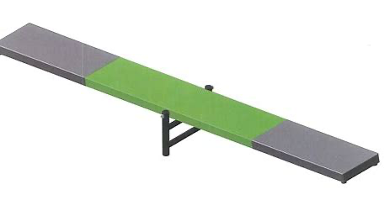
From Anxiety to Resilience
Resilience
Prevention
Anxiety

Slide 5
Resilience
Resilience: ‘Positive adaptation despite adversity.’
Research that ‘resilience’ can be promoted is extensive*
Factors both within and outside the child promote it
Biopsychosocial approach
At the individual level promoting resilience can help the child with autism improve their:
Social responsiveness/attachment
Positive temperament
Intelligence/Academic achievement
*https://www.ncbi.nlm.nih.gov/pmc/articles/PMC2956753/

Slide 6
The Resilient Child

Slide 7
Resilience Leads to Emotional Intelligence
Mature handling of negative feelings and impulses
Self efficacy/self esteem/sense of self
Internal locus of control. Understanding whose problem is it?
Sense of humor
Hopefulness
Perspective: Don’t sweat the small stuff
(And it’s all small stuff.) How dangerous is life really?
Flexibility
Fortitude, persistence
Creative, imaginative, playful
Enduring set of values
https://www.ncbi.nlm.nih.gov/pmc/articles/PMC2956753/

Slide 8
Family Factors That Promote Resilience
Parent warmth
Marital and extended family support
Belief in child
Accepting the child for who they are
High Sensitivity to sensory integration needs
Recognizing the validity of the child’s feelings
Non-blaming, non-punitive
Message of competence/philosophy of ‘can’
High expectations/Not ‘infantilizing’
Promote play, imagination, and pretend
https://www.ncbi.nlm.nih.gov/pmc/articles/PMC2956753/

Slide 9
Pretend: High Road to EI

Slide 10
The Importance of Imagination
Promoting imagination and pretend play is the child’s highest form of emotional thinking
FDL’s 5 and above
Pretend leads to problem solving
Sense of humor
Perspective taking
Emotional intelligence
Social skills

Slide 11
Other Resilience Factors
Positive school experience
Good teachers, friendly peers
The ‘cultural surround’
Religion/Spirituality
Avoidance of trauma
Loss/death of a parent
School shootings
Stressful life events
Divorce
Poverty
Illness
Immigrant status
Cultural/historical events—colonialism, racism,
https://www.ncbi.nlm.nih.gov/pmc/articles/PMC2956753/

Slide 12
Seven Sources of Anxiety
Genetics
Family Systems
Develop-mental
Social
Emotional
Educational
Temper-ament
Mammalian
Fear
Existential
Self-reg
More biological
More existential

Slide 13
From Resilience to Anxiety
Resilience
Prevention
Anxiety

Slide 14
In Autism & Anxiety: Part 1
I presented the case for using anxiety and upset to promote coping, resilience, and improved development
Two-edged sword: The higher development, the more fears and anxieties
If not recognized and handled well it can not only impair developmental progress but lead to chronic anxiety
Fear, Panic, and Rage are ‘built in’ to our brains (Panksepp)
‘He comes by it honestly’: The Genetics of Anxiety
Socially – there are so many fears and worries that the child cannot cope and all efforts to self regulate don’t work
How do we help our poor kids with autism with all the demands and stresses of life?
Notes:
But you can’t hide your head in the sand. Damned is you do and damned it you don’t. But more damned if you hide.

Slide 15
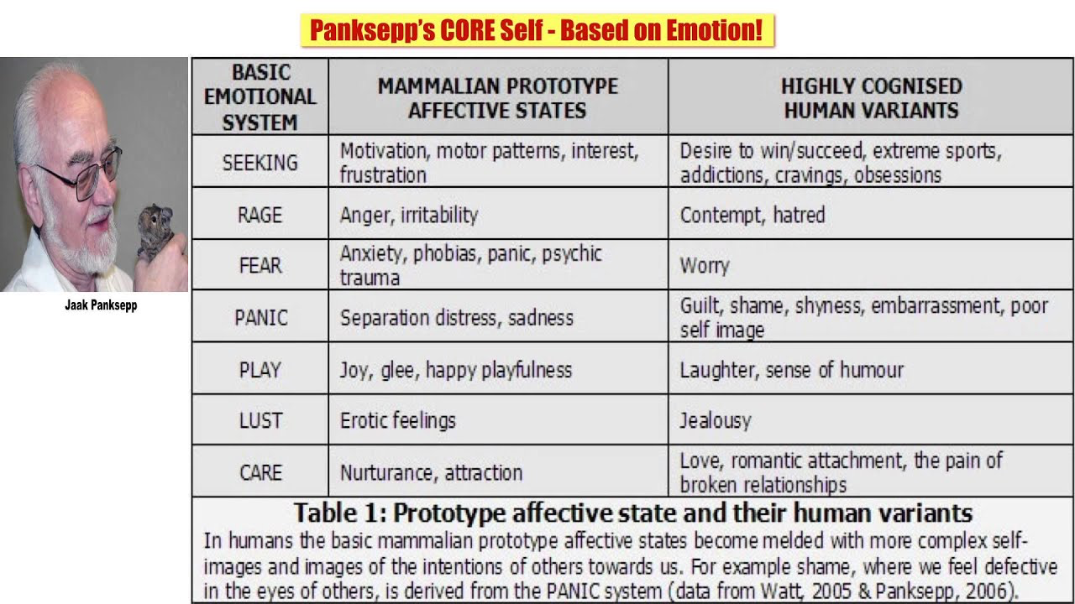
Jaak Panksepp’s Emotional Brain Tracks

Slide 16
Genetics of Anxiety
Am J Med Genet C Semin Med Genet
2008 May 15;148C(2):118-26.
doi: 10.1002/ajmg.c.30174.
The genetic basis of panic and phobic anxiety disorders
Jordan W Smoller ¹, Erica Gardner-Schuster, Jennifer Covino
PMID: 18412108
DOI: 10.1002/ajmg.c.30174
Abstract
Panic disorder and phobic anxiety disorders are common disorders that are often chronic and disabling.
Genetic epidemiologic studies have documented that these disorders are familial and moderately heritable. Linkage studies have implicated several chromosomal regions that may harbor susceptibility genes; however, candidate gene association studies have not established a role for any specific loci to date.
Increasing evidence from family and genetic studies suggests that genes underlying these disorders overlap and transcend diagnostic boundaries.
Heritable forms of anxious temperament, anxiety-related personality traits and neuroimaging assays of fear circuitry may represent intermediate phenotypes that predispose to panic and phobic disorders.

Slide 17
Billy’s Family Genogram
Live in a different state
No contact with this side of family
Strict Military
OCD tendenciesCollector/hoarder
Alcoholic
Anxious
Depressed
Marital Tension
Anger
Issues
Angry
Anxious
Lax
Strict
Moody
Bipolar?
Sec’y
IT Consultant
Not supportive
6 yrs
10 yrs
5 yrs
8 yr
14 yrs
Billy
Notes:
17

Slide 18
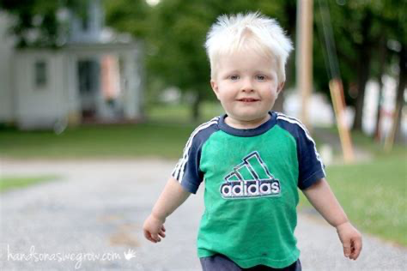
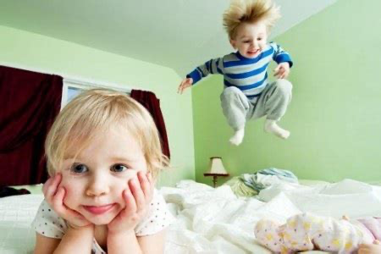
Temperament
Individual Differences—Removes Blame
Activity Level
Sensitivity
Regularity
Approach/Withdrawal
(Slow to warm up)
Adaptability
Mood
Intensity
Persistence
Distractibility
http://csefel.vanderbilt.edu/briefs/wwb_23.pdf

Slide 19
Seven Sources of Anxiety
Genetics
Family Systems
Develop-mental
Social
Emotional
Educational
Temper-ament
Mammalian
Fear
Existential
Self-reg
More biological
More existential

Slide 20
Development, Anxiety, Autism & FEDL
HIGH
FDL
1-2
FDL3
FDL 4
FDL 5
FDL 6-7
A
N
X
I
E
T
Y
LOW

Slide 21
Anxieties are Stage and Age Related
Early Childhood
Resilience
School Age
Anxiety Disorder
Adolescent
Add Identity issues
OCD
Part 2 Moving from Anxiety to Disorder
Existential stressors
Part 1: Preventing the progression to disorders
Depression
Social Anxiety
PTSD
Usual Developmental Anxiety and Stress

Slide 22
In Autism & Anxiety: Part 1
I presented the case for using anxiety and upset to promote coping, resilience, and improved development
Two-edged sword: The higher development, the more fears and anxieties
If not recognized and handled well it can not only impair developmental progress but lead to chronic anxiety
Fear, Panic, and Rage are ‘built in’ to our brains (Panksepp)
He comes by it honestly: The Genetics of Anxiety
There are so many fear/anxiety forces that the child cannot cope and all efforts to self regulate don’t work
How do we help these kids with autism with all the demands and stresses of life?
Notes:
But you can’t hide your head in the sand. Damned is you do and damned it you don’t. But more damned if you hide.

Slide 23
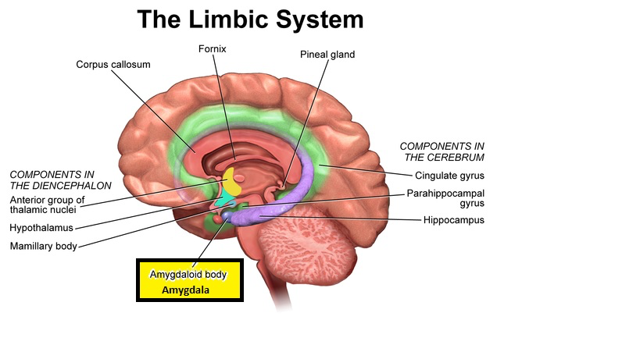
Sometimes Biology Wins

Slide 24
Zone of Optimal Engagement Marie Anzalone, Sc.D. OTR
Behavioral Disorganization Distractibility,
with Over-Responsivity
Threshold for Aversion
Zone of Optimal Engagement
Threshold for
Orientation
Inattentive, Low Arousal and Attention with Under-Responsivity

Slide 25
Children with Autism Want to. .
Keep the World
the Same!
A Habit In Motion
Stays in Motion
AKA: “Intolerance of uncertainty”

Slide 26
From Resilience to Anxiety
Anxiety
Prevention
Resilience

Slide 27
When Anxiety Becomes A Disorder
Notes:
Can we get the PLAY logo on here somewhere?

Slide 28
The Progression of Fear
Anxiety Disorder
OCD
Depression
Anxiety
(To Choke)
Fear
(Calamity, danger, revere)
Part 2
Today
Part 1
The Case of Billy

Slide 29
Anxiety: DSM 5 Diagnoses
Generalized Anxiety Disorder
Obsessive Compulsive Disorder
Specific Phobias (e.g. school alarms, driving the wrong way, being told ‘No’.)
PTSD
Separation anxiety disorder
Social Anxiety Disorder
Panic Disorders
Depression
My Focus
Today

Slide 30
Autism & Anxiety Disorders
40% of autistic children, adolescents and adults are thought to have at least one and often more anxiety disorders (van Steensel et al., 2011), with specific phobias and social anxiety among the most common forms
Unfortunately, it can be difficult to identify anxiety disorder in autism because it frequently presents in an unusual way (Kerns et al., 2014) as the case of Billy shows

Slide 31
General Anxiety Disorder DSM 5
Excessive anxiety and worry about a variety of topics, events, or activities
Worry occurs more often than not for at least six months and is clearly excessive
The worry is experienced as very challenging to control. The worry may easily shift from one topic to another
In children, only one of these symptoms is necessary for a diagnosis of GAD:
Edginess or restlessness
Tiring easily; more fatigued than usual
Impaired concentration or feeling as though the mind goes blank
Irritability (which may or may not be observable to others)
Increased muscle aches or soreness
Difficulty sleeping (due to trouble falling asleep or staying asleep, restlessness at night, or unsatisfying sleep)

Slide 32
Relevant Clinical Questions
Is your child ‘a worrier’?
Worries about everything?
Worries about nothing?
Obsesses
About time and the future
Transitions
Lack’s perspective about what’s important
Shows up as excessive fears
Storms
Bees, bugs
Loud noises

Slide 33
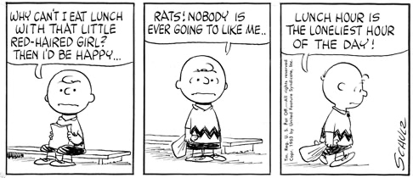
Anxiety Disorder
Begins as ordinary
Becomes excessive
Affects daily life

Slide 34
When Anxiety Becomes an Anxiety Disorder?
When behavioral, developmental, early intervention is not working
When the child is developmentally at FDL 6+
When the child is older—age 7+
When the child is 80 lbs or heavier
When functioning is impaired
When the suffering is persistent/daily
When misbehavior, tantrums, and aggression emerge as part of escalating anxiety
https://www.nhsinform.scot/illnesses-and-conditions/mental-health/anxiety-disorders-in-children

Slide 35
When Anxiety Becomes A Disorder: A Case Study—Billy
Notes:
Can we get the PLAY logo on here somewhere?

Slide 36
Case Study: FDL 6+: Jane (Mom), Rob (Dad) and Billy
Billy is 10, 3rd grade, in an ASD self contained classroom because of outbursts.
Peers are afraid of Billy. Touches them w/o asking. No real friends
Struggling with academics and avoidant of schoolwork
FDL Profile:
FDL 1*: 75% ‘Thomas’ trains, Dinosaurs, iPad, music, Disney movies
FDL 2: 100% Easy to engaged. Well attached
FDL 3: 75-100% Interacts well for 5-10 circles but loses interest, very busy, easily distracted
FDL 4: 75% Trouble sustaining long continuous flow
FDL 5*: 75-100% Loves pretend. Swords, doctor, Thomas Trains. Loves Pixar movies. Talks well but in the form of questions
FDL 6: 50-75% Can recall the past. Puts 2 ideas together logically. Just beginning to ask/answer ‘Why’ questions. Loves going to Red Robin. Perseverates on “Going to Red Robin?”
Physically big and strong (> 90 lbs). Early puberty?

Slide 37
Case Study: FDL 6+: Jane (Mom), Rob (Dad) and Billy
Billy’s sensory integration issues
Hates loud sudden noises
Sneezes, coughs, honking cars, school bells, alarms
Noisy chaotic environments
Trouble with transitions—Wants to keep the world the same
Visual and map cognition OCD
Always wants to go the same way in the car
Food can’t touch on the plate
Visual stimmer: lines up trains, loves iPad/Videos
Loves deep pressure/touch & tickles
Touches peers in school
Jumper and hand flapper especially when anxious or excited

Slide 38
Case Study: FDL 6+: Jane (Mom), Rob (Dad) and Billy
HWWHWWHW and if he doesn’t get it—watch out!
Billy yells/screams, runs away, major tantrums increasing with hitting 1-2x/week. Triggered by anxiety. Impulsive
Psychiatrist wants to put him Risperidone
Temperament is difficult, demanding, impatient, impulsive, and anxious
Would spend hours on his iPad. It calms him down
I diagnosed him with ‘Mild to Moderate Autism’, ‘Regulatory Disorder’, and ‘Anxiety Disorder’
Dysregulation characterized by avoidance at one end and explosive temper at the other end of the self regulation continuum—often due to anxiety

Slide 39
Regulatory Modulation Continuum (Range of Response)
Shutdown
Habituate
Attend
Flight-Fight
Shutdown
Failure to Orient
<Homeostasis>
Over Orientation
High Neurologic Threshold
Poor Registration
Sensation Seeking
Low Neurophysiologic Threshold
High Sensitivity to Stimuli
Fight or Fright
Sensory avoiding
Flight or freeze
Children with Temper
Dysregulation Disorder
swing quickly between
both ends of the continuum
Notes:
The title content bars will be Failure to Orient and Over Orientation

Slide 40
Case Study: FDL 6+: Jane (Mom), Rob (Dad) and Billy
Strong family history of anxiety, depression, alcoholism, bipolar disorder
The parents are divided
Mom is tenderhearted and has trouble placing limits on Billy
Dad is a workaholic IT guy, rigid, strict, and mom suspects ‘He is on the spectrum’
There are two siblings one younger sister who is angry that Billy gets so much attention
One older brother who is going through puberty and has withdrawn to his room from family life
Billy worries ‘about everything’ and ‘nothing’ especially coming events, and school
Signs of OCD behavior
Has to go the same way in the car. Food can’t touch on plate

Slide 41
Billy’s Family Genogram
Live in a different state
No contact with this side of family
Strict Military
OCD tendenciesCollector/hoarder
Alcoholic
Anxious
Depressed
Marital Tension
Anger
Issues
Angry
Anxious
Lax
Strict
Moody
Bipolar?
Sec’y
IT Consultant
Not supportive
6 yrs
10 yrs
5 yrs
8 yr
14 yrs
Billy
Notes:
41

Slide 42
Case Study: FDL 6+: Jane (Mom), Rob (Dad) and Billy
Strong family history of anxiety, depression, alcoholism, bipolar disorder
The parents are divided
Mom is tenderhearted and has trouble placing limits on Billy
Dad is a workaholic IT guy, rigid, strict, and mom suspects ‘He is on the spectrum’
There are two siblings one younger sister who is angry that Billy gets so much attention
One older brother who is going through puberty and has withdrawn to his room from family life
Billy worries ‘about everything’ and ‘nothing’ especially coming events, and school
Signs of OCD behavior emerging
Has to go the same way in the car. Food can’t touch on plate

Slide 43
xxxxxxxxxxxxxxxxxxxxxxxxxxxxxxxxxxxxxxxxxxxxxxxxxxxxxxxxxxxxxxxxxxx
xxxxxxxxxxxxxxxxxxxxxxxxxxxxxxxxxxxxxxxxxxxxxxxxxxxxxxxxxxxxxxxxxxx

Slide 44
Biology Wins

Slide 45
When Anxiety Becomes A Disorder: The Approach
Notes:
Can we get the PLAY logo on here somewhere?

Slide 46
Anxieties are Stage and Age Related
Early Childhood
Resilience
School Age
Anxiety Disorder
Adolescent
Add Identity issues
OCD
Part 2 Moving from Anxiety to Disorder
Existential stressors
Part 1: Preventing the progression to disorders
Depression
Social Anxiety
PTSD
Usual Developmental Anxiety and Stress

Slide 47
Main Interventions for Anxiety
Reduce school stresses
Address family issues
Sensory relief
Transition Tricks
Address Alexithymia (50% with ASD can’t recognize their own emotions).
Improve emotional thinking/reasoning
Use CBT, social stories, fables, and pretend
For OCD: Exposure & Response Prevention

Slide 48
Case Study: FDL 6+: Jane (Mom), Rob (Dad) and Billy
At FDL 5-6, Billy has gained two main cognitive abilities that can increase anxiety or reduce it. . .
If you know what to do!
Can recall the past and predict the future
Can put two ideas together logically
Typically, this makes it easier to explain things, so anxiety reduces
But Billy can imagine fears, has OCD, so anxiety increases
Paradoxically, when parents and school increase the demands because of developmental gains, this leads to more anxiety!
Erickson’s ‘Autonomy vs Guilt’
FDL 5-6 children are seeking autonomy if parents promote it
Billy is overwhelmed/made anxious with demands and ‘shoulds’

Slide 49
Developmental Anxiety, Autism & FEDL
HIGH
Goal: Decrease anxiety by
helping Billy regulate himself
FDL
1-2
FDL3
FDL 4
FDL 5
FDL 6
A
N
X
I
E
T
Y
LOW

Slide 50
Sources of Anxiety for Billy
School stress
Family stresses
Sensory issues
Transitions
Alexithymia
Genetic and temperamental anxiety
OCD tendencies

Slide 51
Main Interventions for Anxiety
Reduce school stresses
Address family issues
Deal with sensory issues
Transition Tricks
Address Alexithymia (50% with ASD can’t recognize their own emotions)
Improve emotional thinking/reasoning
Use CBT, social stories, fables, pretend, and body/mind techniques
For OCD: Exposure & Response Prevention
Medications

Slide 52
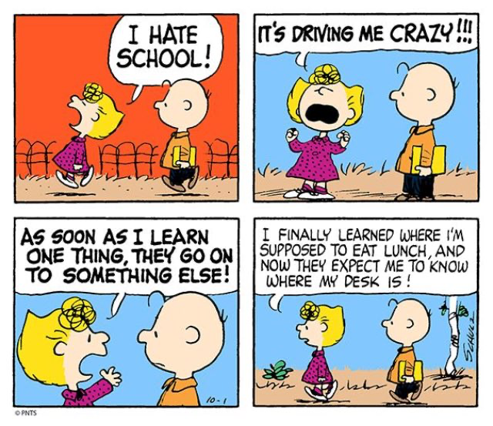
Reduce School Stress
School for kids
with ASD is
often very
STRESSFULL!!

Slide 53
Billy’s School Stresses
Jane: “Teachers just don’t ‘get’ Billy.”
Peers seem to shun Billy. He wants to be social but doesn’t know how to be
Because he is older and bigger he spends a lot of academic time with reading and phonics, ‘why’ questions, and reading comprehension
When the demands of school get too stressful, he acts out
Stoplight behavior charts are making him anxious
School is calling the family when Billy acts out threatening to suspend him
They have to clear the classroom

Slide 54
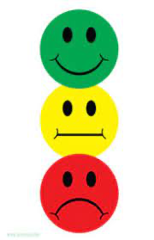
Behavior Charts
Schools often use behavior charts to give students feedback about their behaviors.
This in NOT helpful for children with anxiety
Often puts pressure on them and worsens anxiety.
Rewards for good behavior can be helpful but only when combined with CBT approaches

Slide 55
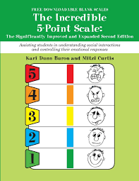
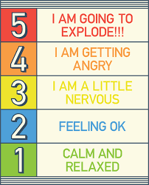
The Incredible 5 Point Scale

Slide 56
Billy’s School Stresses
Jane: “Teachers just don’t ‘get’ Billy.”
Peers seem to shun Billy. He wants to be social but doesn’t know how to be
Because he is older and bigger he spends a lot of academic time with reading and phonics, ‘why’ questions, and reading comprehension
When the demands of school get too stressful, he acts out
Stoplight behavior charts are making him anxious
School is calling the family when Billy acts out threatening to suspend him
They have to clear the classroom

Slide 57
Reduce School Stress
Reduce the demands at school. Make learning fun!
Billy is more like a kindergartener academically
Focus learning on what he loves
‘Thomas’, Dinosaurs, iPad, music, Disney movies—write these into his IEP
Focus on his feeling life—help him label his feelings
Beware of sensory issues—’They do give him breaks.’
Talk to peers about autism and how they can help Billy
Ask, in writing, for a Behavior Intervention Plan (BIP)
DO NOT TAKE BILLY OUT OF SCHOOL FOR MISBEHAVIOR!
Parents: Put every important communication with the school in WRITING!

Slide 58
Main Interventions for Anxiety
Reduce school stresses
Address family issues
Deal with sensory issues
Transition Tricks
Address Alexithymia (50% with ASD can’t recognize their own emotions).
Improve emotional thinking/reasoning
Use CBT, social stories, fables, pretend, and body/mind techniques
For OCD: Exposure & Response Prevention
Medications

Slide 59
Address Family Issues
Mom and dad must be on the
same page with ‘rules for
reasons and consequences’
(See The Good, The Bad & The Ugly)
Dad: “Billy doesn’t listen.”
Give a ‘message of competence’
by expecting Billy to do what he can
Have a family meeting so
sib resentment can be heard
Family counseling as needed

Slide 60
Main Interventions for Anxiety
Reduce school stresses
Address family issues
Deal with sensory issues
Transition Tricks
Address Alexithymia (50% with ASD can’t recognize their own emotions).
Improve emotional thinking/reasoning
Use CBT, social stories, fables, pretend, and body/mind techniques
For OCD: Exposure & Response Prevention
Medications

Slide 61
Deal with Sensory Issues
Billy has clear sensory likes and sensory stressors
Prefers deep pressure, loves water/baths, loves rides, loves iPad visual stim and music
These are all very soothing and parents use them, when possible, to reduce stress and anxiety
Loud sudden noises, chaotic environments, going the wrong way in a car, certain foods textures and smells, food touching on the plate are sensory triggers for anxiety
Do we accept his sensory sensitivities, or do we help Billy tolerate them? Both. See OCD later

Slide 62
Main Interventions for Anxiety
Reduce school stresses
Address family issues
Deal with sensory issues
Transition Tricks
Address Alexithymia (50% with ASD can’t recognize their own emotions).
Improve emotional thinking/reasoning
Use CBT, social stories, fables, pretend, and body/mind techniques
For OCD: Exposure & Response Prevention
Medications

Slide 63
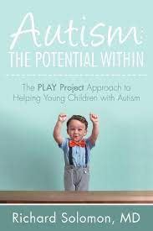
Dr. Rick’s 20 Transition Tricks
See ‘Tricks’
Chapter
Attached
See attached Chapter

Slide 64
Children with Autism Want to. .
Keep the World
the Same!
A Habit In Motion
Stays in Motion
AKA: “Intolerance of uncertainty”

Slide 65
A Developmental Approach to Transitions
Developmental readiness is key
Billy has made very good developmental progress now at FDL 5-6
Talking in short sentences in the form questions
Want to go outside? Go to Red Robin? Want my iPad?
Very good receptive language. Understands past and future, what, where, who, and some why and when questions
Follows 2-3 step commands
He wants his way, doesn’t listen very well at all and has terrible problems with transitions
Notes:
The main idea behind TPP is that children with ASD have a lot of potential to gain developmental milestones. When parents put in the time to help their children in the home setting, the child will move up developmentally, start talking, understand more and more, and improve emotionally and socially. While some of the TT will work for children who are non verbal, the ones I’m going to be talking about require the developmental achievements mentioned here.

Slide 66
A Developmental Approach to Transitions
Learn some practical ways to better manage transitions with your child or client on the spectrum that will:
Develop the child’s INTERNAL control systems
Help them truly make sense of the world and their feelings
Help them feel less anxious and more secure
Increase social interaction
Transition tricks are a form of CBT
Notes:
These transition tricks are part of my developmental approach to autism. I believe that we must help children on the spectrum to:
Develop INTERNAL control systems
truly make sense of the world and their feelings so they doesn’t get so overwhelmed
Feel less anxious and more secure
Engage in meaningful social interaction around the things they care about

Slide 67
Transition Trick #1: Mirror Feelings
Telling not asking: Being a mirror
Labeling feelings. Give Billy words for his feelings
‘All done! No more! Stop!’ (‘Good negative’ words)
Children feel understood
Just “use your words, Billy.” No need to have a fit.
Leads to coping and handling changes like transitions
Remember: Misbehavior is the immature expression of a legitimate feeling
Notes:
The first principle is: Mirror Feelings
Simply telling the child how she feels will reduce her anxiety
Research shows that labeling emotions for children makes them feel more manageable and less overwhelming

Slide 68
Quiz
Scenario: It is time for dinner, Billy does not want to watching his favorite Disney show
Which of these statements uses the Transition Principle “Mirroring Feelings”?
“I’ve given you 3 warnings, now it is time to turn the TV off!”
“You don’t want to turn off the TV. You want to keep watching your favorite show.”
“I know you want to keep watching TV, but it is time for dinner.”
Notes:
Answer: #2
1 does not reflect feelings at all. 3 acknowledges the child’s feeling, but still focuses on the parent’s agenda. When we truly mirror feelings, we give them the words to label the feeling, then pause and allow the child to process and confirm what we are saying.

Slide 69
Transition Tricks: Create Structure
Calendars (for month and week),
Schedules (for day)
Lists (for the hour) and
Get dressed, watch Thomas in the car, drive to the doctor, eat at Red Robin, go home
Sequences (for the minute). The ‘First/Then’ technique
Good for getting dressed, brushing teeth, taking a bath
First underwear, then shirt, pants, and socks
Structure for events
Notes:
Creating structure means making the unpredictable predictable by breaking down time into smaller parts and representing them visually in pictures or written lists for those who can read. I’m sure that many of you . . .
a) Use calendars (for month and week) which let the child know which big events are happening this week and,
b) schedules (for day), which are often used in schools but what about
c) lists (for the hour) like. . .
d) sequences (for the minute). A common variation of sequences is ‘first/then’ technique. First you watch TV, then you come to dinner.

Slide 70
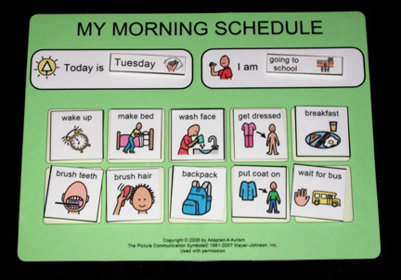
Activity: Visual Supports
Images of schedules and calendars
Notes:
Handout: worksheet for weekly/daily/hourly planning

Slide 71
Transition Techniques
No Sudden “Nos”!
Tussling “I’ll tell you what. I got an idea.”
Not only helps with transitions, but also builds social skills
Increases back and forth interaction (”Circles of Communication”
Preview/Review
Notes:
OK. We’ve covered a key principle, a key strategy. So let’s talk about a few techniques, specific tricks you can use when the child just doesn’t want to move!
First a warning. “No Sudden No’s” I tell parents all the time, don’t start with NO! Watch TV? No! This will frequently upset the child who doesn’t want the world to change and then they did their heels in. Better to reflect feelings first. O you want to keep watching TV. I see. It’s time to eat. If the child say “no’ then you can use tussling and preview review.
Tussling involves having a long conversation, a long argument that includes processing feelings, discussing reasons, warning about consequences, having a sense of humor
Tv? Dinner! Tv? Dinner. Come on, come to dinner. OK, next commercial One more minute.
Preview review would go like this: Jacob if you don’t come to dinner we are will fight, turn off the tv, you will cry you will go to your room and be sad. If you turn off TV come to dinner we eat and talk and laugh. Come on to dinner. After Jacob comes to the dinner table you say: “See Jacob, you turned off TV you came to dinner and ate and we had fun as a family.”

Slide 72
Clean up breakdown for Billy
Scenario: It’s time to clean up and have lunch, in school. But Billy is engrossed in playing trains. She says “All done, Billy. No trains. Time for lunch.” and he gets annoyed but doesn’t listen. The teacher takes Billy’s train away during clean-up time and he becomes upset and has a tantrum with aggression
How could she have Mirrored Feelings?
How could she have used Structure?
How could she have avoided a Sudden NO?
Notes:
Show video, then give answers
She could. . .
Say, “You want to keep the train! You don’t want to put the train away!”
Walked him over to the visual schedule (while he holds the train!) to show him when he can have the train back (during free time or lunch, etc.)
Tussle with him instead of taking the train from his hand. “How about this: you get one more minute with the train, then we will put it on the shelf where you can see it.”
Let him keep the train as long as he is not disruptive with it!

Slide 73
Transition Tricks: Preview/Review
I know buddy you just want to play with your trains and you do not want to stop and go back to school. No school work! Trains! (‘Good negative’ language)
You know what will happen if you don’t go back to school work? We will have a fight. You will cry and you will not be able to play with your trains. You will be very sad
If you stop playing with your trains and go back to school and finish your work then you can come back and play with the trains
Similar in many ways to CBT and Social Stories

Slide 74
Conclusion: Benefits of Transition Tricks
Teach the child how to cope with change and delay gratification
Teach the child to be more flexible and mature in the face of change
Give structure to make the transition predictable and ‘keep the world the same’
Give a framework for fears that’s calming
Create ‘perspective’
Reduce temper tantrums by helping the child ‘use their words’ and make better choices
Improving social/emotional understanding paves the way for true social skills
Notes:
I hope you could see how helpful and important these TT can be for child with autism (not to mention the parents of the child with autism!)
These tricks give the child words for their feelings introduce the idea of time and consequences. They teach the child how to cope with change and delay gratification while reducing immature temper tantrums. Ultimately they teach the child to be more flexible and mature in the face of change. A lesson that is a major achievement for the child with autism.

Slide 75
Main Interventions for Anxiety
Reduce school stresses
Address family issues
Sensory relief
Transition Tricks
Address Alexithymia (50% with ASD can’t recognize their own emotions)
Improve emotional thinking/reasoning!!
Use CBT, social stories, fables, and Replays/ pretend
For OCD: Exposure & Response Prevention
Medication

Slide 76
Address Alexithymia
Alexithymia is the inability to recognize one’s own emotions
The main strategies (See above several examples) is the mirror the child’s feelings back to them in a way they can understand.
CBT for Children/Adolescents with ASD
Social stories (Carol Gray)
The Incredible 5 Point Scale
Fables
Pretend (‘Replays’ & ‘Attacking Anxiety’ by Karen Levine)

Slide 77
In CBT: Thoughts Drive Feelings
Cognitive behavioral therapy has been shown through research to improve anxiety in children with ASD (see references)
CBT: ‘Talking back to thoughts’
Step One – Make A List of Anxieties
Step Two – Understand the Unproductive Thoughts
Step Three – Create Replacement Thoughts.
Step Four – Revisit the list and thoughts often.
Step Five – Notice And Replace with better thinking.
‘Mind’ over ‘Brain’

Slide 78
With CBT, Mind Wins
The Frontal Lobe
Wins!!

Slide 79
Social Stories, Fables, & Replays
Give words to feelings (addresses alexithymia)
Gives reasons that promote understanding
Give perspective about what is real vs what is imagined (reduces anxiety)
Promote mastery of difficult feelings and situations through repetition
Re-gaining control and self regulation through frontal lobe/top down understanding
Incentives are not reasons

Slide 80
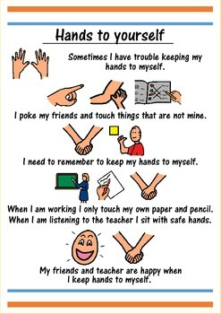
Billy’s Social Story About Touching
Because
We don’t like
surprise touches!!

Slide 81
Main Interventions for Anxiety
Reduce school stresses
Address family issues
Deal with sensory issues
Transition Tricks
Address Alexithymia (50% with ASD can’t recognize their own emotions).
Improve emotional thinking/reasoning
Use CBT, social stories, fables, Replays/pretend, and body/mind techniques
For OCD: Exposure & Response Prevention
Medications

Slide 82
Fable: The ‘Right Way’ Rabbit
Fables are like social stories but more complex psychologically
Like fables they have ‘a moral’ or insight
I wrote a fable for Billy called ‘The Right Way Rabbit’
Who only wants to go ‘the right way’ home.
Along with a full developmental approach, this helped Billy become less rigid and less anxious about his map cognition
See the handouts for the webinar

Slide 83
Replays™--Karen Levine
Pretend play that is therapeutic can be used for deeper work
With Billy, I taught Jane, his mom,how to use the ‘Replays’ approach to help Billy with his fears about the fire alarm and school bells at school
He hates them and was traumatized by them
When we ‘replayed’ a scenario with a little character who went screaming out of school when his mom ‘dinged’ a little bell Billy loved it and wanted to do again i.e. he wanted to ‘replay it’

Slide 84
Desensitization
Desensitization is the gradual exposure to an anxiety producing situation
First mom just talked about school alarms and what they were for
Then she showed him the picture of one
Then she rang a small bell at home (see Replays)
Then she played a school alarm on You Tube
Then she asked the school to warn Billy about upcoming alarms so he could wear headphones
It worked. School bells didn’t make him anxious

Slide 85
Main Interventions for Anxiety
Reduce school stresses
Address family issues
Deal with sensory issues
Transition Tricks
Address Alexithymia (50% with ASD can’t recognize their own emotions)
Improve emotional thinking/reasoning
Use CBT, social stories, fables, pretend/Replays, and Body/mind techniques
OCD: Exposure & Response Prevention (ERP)
Medications

Slide 86
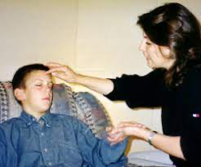
Relaxation, Breathing, and Imagination
For a relaxation, breathing, and imagination script see resources for this webinar

Slide 87
The Progression of Fear
Anxiety Disorder
OCD
Depression
Anxiety
(To Choke)
Fear
(Calamity, danger, revere)
Part 1
Part 2
Today

Slide 88
Main Interventions for Anxiety
Reduce school stresses
Address family issues
Deal with sensory issues
Transition Tricks
Address Alexithymia (50% with ASD can’t recognize their own emotions).
Improve emotional thinking/reasoning
Use CBT, social stories, fables, Replays/pretend, and body/mind techniques
For OCD: Exposure & Response Prevention
Medications

Slide 89
Interventions for OCD
OCD definition*
Obsession: a persistent disturbing preoccupation with an often unreasonable idea or feeling
Compulsion: repetitive behaviors or mental acts that a person feels driven to perform in response to an obsession
Autistic habits vs OCD: A common confusion
‘A Habit in Motion Stays in Motion’ makes it hard to distinguish sometimes as repetitive interests are NOT OCD
But Billy definitely has OCD
*See References for the CYBOCS Scale

Slide 90
ASD + OCD
It is estimated that 17–37% of young people with ASD also experience OCD symptoms although the proportion of youth with OCD who also meet diagnostic criteria for ASD is less clear
Several studies have suggested that young people with OCD and co-occurring ASD have clinically distinct psychopathology and impairment compared to those with ASD or OCD only
However, these study findings may lack generalizability as they are limited by small sample sizes and selective recruitment
Download ‘OCD British Review.pdf’

Slide 91
Interventions for OCD
A robust evidence-base supports the efficacy of CBT
When Exposure and Response Prevention—ERP are not completely effective. . .
Selective serotonin reuptake inhibitors (SSRIs) are indicated for the treatment of pediatric OCD*
Increasing evidence for children with ASD + OCD
Desire to get better is very important
Include the child
Brain over Mind
National Institute for Health and Care Excellence.
https://www.nice.org.uk/guidance/cg31/evidence/fullguideline-194883373

Slide 92
OCD
Billy has OCD
Obsessed with going the ‘wrong way’
Compelled to keep his his food from touching
Gets very anxious when people tell him ‘No’
Hates loud sudden noises (crying, sneezes, bells)
CBT has been shown to be effective for OCD
We discussed Fables and Replay as a ERP
The child must want to get better from it

Slide 93
Medications
Despite the comprehensive interventions for Billy’s anxiety which helped him a lot. . .
His genetics, OCD tendencies, and stressors left him anxious
He was having regular upsets, misbehavior and aggression
He was suffering
He had trouble sleeping on Sundays before school
His mom was stressed
School was calling weekly about behavior
He needed medications

Slide 94
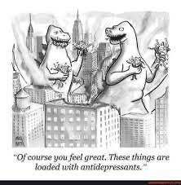
Medications

Slide 95
Medications for Anxiety
SSRIs: GAD, Mild Depression
Prozac/Fluoxetine
Zoloft/Sertraline (OCD)
Buspirone
Risperdal
Impulsive Aggression
Sleep
Melatonin
Clonidine

Slide 96
Medications
I started Billy on Zoloft and adjusted the dose to help him with his anxiety and OCD
It worked, substantially reducing his anxiety, pre-occupations, and obsessions
His behavior in school improved
His mom reported much less perseveration
Car rides had improved but now he was calmer
School alarms were not as upsetting
I added some clonidine at night on Sundays for sleep.

Slide 97
The Progression of Fear
Anxiety Disorder
OCD
Depression
Anxiety
(To Choke)
Fear
(Calamity, danger, revere)
Part 1
Part 2
Today

Slide 98
Main Interventions for Anxiety
Reduce school stresses
Address family issues
Deal with sensory issues
Use Transition Tricks
Address Alexithymia (50% with ASD can’t recognize their own emotions).
Improve emotional thinking/reasoning
Use CBT, social stories, fables, pretend/Replays, and body/mind techniques
OCD: Exposure & Response Prevention (ERP)
Medications

Slide 99
Anxiety & Autism: Conclusion
The goals of intervention for anxiety and autism are two-fold:
First, to help the child not suffer
Second to promote the child’s potential to grapple with the increasing complexities of life
By taking a comprehensive approach we can prepare the child developmentally, emotionally, and socially
By dealing with emotions, like fears and anxieties, promoting imagination and problem solving, we prepare the way for self understanding and social skills.
For the child with autism, it is primarily through self understanding that we help him or her understand others, develop empathy, and emotional intelligence

Slide 100
Conclusion
Bobby McFerrin

Slide 101
Thank you
Thank you for attending!
We’ll send out a link to the recording of this webinar, and post it within the PPC portal on our website
Mark your calendars! Next Licensed PLAY Project Webinar is:
February 16th, 2022 @ 12pm ET

